Slide 1
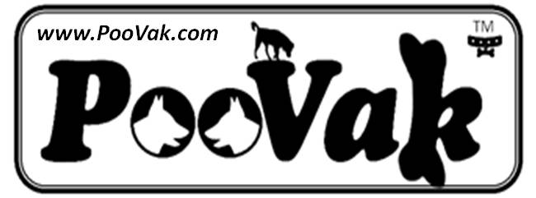
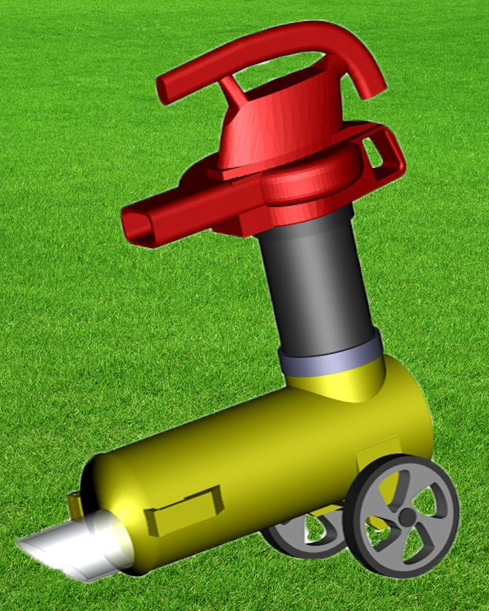
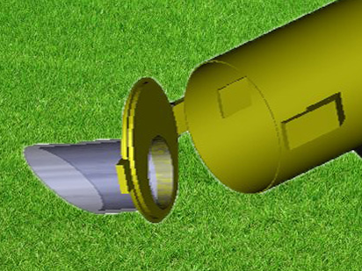
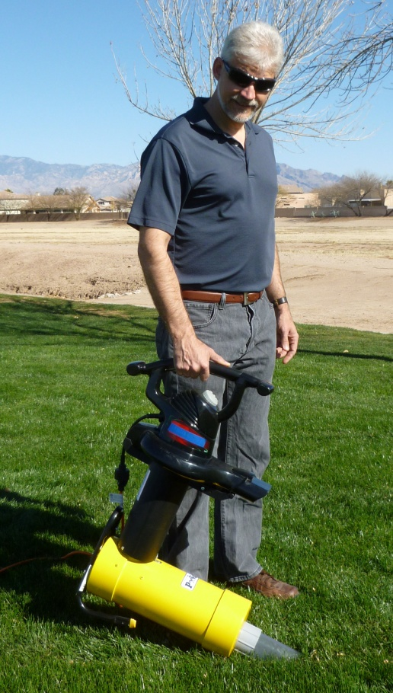
The PooVak® is a specially designed canister that attaches to
a Leaf Blower/Vac for the task of vacuuming and collecting
Pet Waste (or any small debris) into a disposable bag.
The PooVak™ is Patented as an Attachment or Accessory to a leaf blower, US 8631540 B2, Jan 21, 2014. PooVak® is a US Registered trademark, Reg. No 4203910. See Product info, videos, and customer reviews at www.PooVak.com. Contact: Jerry (520) 990-1389
Prototype has been Market Tested to over 100 Pet Owners in 2012 - 2013
CUSTOMER REVIEWS of Prototype:
ABSOLUTELY AMAZING!!
Our Backs are saved
The Best Invention Since the Wheel.
Clean up is a snap.
Rave reviews my friend, rave reviews.
picks up all kinds of poop. Easily!
I’ve cut my clean up time to 15 minutes
It used to be difficult to get my son to pick up the poop but now he does it without being asked!
The Poovak is excellent. In a few minutes I was able to pick up the small pieces of dog feces that rest inside the rock garden.
It does very nice with the wet and old flattened waste. Clean-up was very easy.
When we used it for the first time, we had waste in various stages of age and decomposition. Some were very wet, flat and almost part of the turf. It didn't matter, it all came up very nicely and quickly.
Canister Lid fully opens for easy emptying of low cost collection bag
Prototype
Having completed the test marketing phase, PooVak, LLC is currently in Phase 2 of product development.
Phase 2 Goals:
Repackage product for high volume production (model shown).
Partner with a Leaf Blower OEM.
Estimate cost of production and retail price range.
Solicit retail interest in major Pet related retailers and H/W outlets.
-- OR ---
Secure a Licensing Agreement.
Leaf Blower’s leaf collection tube attaches to canister
3D Rendering of Phase 2 Design:
More producible and ergonomic
Lower Cost, (wheels are optional)
By partnering with PooVak LLC, the right Leaf Blower Manufacturer can expand their customer base to the 44 Million households in the US that own dogs, and have a unique retail presence in major pet retailers and online pet related sales outlets. There is no other product quite like the PooVak.

